Slide 1
Software Analysis and Design (CS:324)
Course Instructor: Romasha Khurshid
Email Address: Romasha.Khurshid@nu.edu.pk
Reference Book: Applying UML and Patterns (An introduction to Object-Oriented Analysis and Design And Iterative Development)
BY Craig Larman
Third Edition

Slide 2
Rules that will be strictly followed:
All the assignments and projects will be uploaded and submitted via slate or google classroom.
No assignment will be accepted via email. (Excuses will not be accepted)
All the quizzes will be announced a week before.
Missed quiz will not be retaken. (Excuses will not be accepted)
Announcement:
Project details and course outline will be shared with you soon via Slate.

Slide 3
Tentative Marks distribution:
Assignment:10
Quiz: 10
Project: 10
Sessional: 30
Final: 40
PS: Absolute Grading scheme will be followed

Slide 4
Software?
Computer software, or simply software, is a collection of data or computer instructions that tell the computer how to work.

Slide 5
Software analysis goal:
The goal of requirement analysis phase is answer to question: what software must do (and with what constraints)?
I The goal of software analysis phase is answer to question: how system should work?
I The goal of software development phase is answer to question: how system should be implemented?

Slide 6

Basic OOP Concepts and Terms
Let’s begin with an object and class,
But before starting……
Can anybody differentiate between OOP and Procedural Programming?

Slide 7
Class And Objects:
Activity:
Annotate Around the
Circle.
Class

Slide 8
Class And Objects:
Activity:
Annotate Around the
Circle.
Object

Slide 9
Class And Object:
Object is an entity having their own attributes and operations.
Class is a blueprint, a design and we can say a mold through which different objects are created.

Slide 10
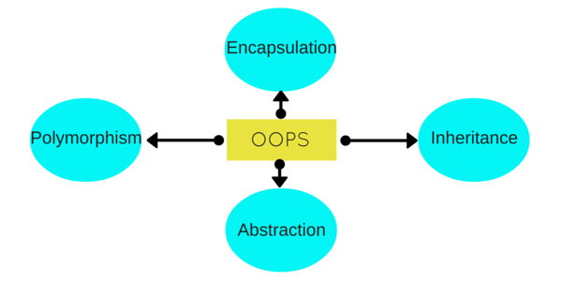
OPPs Pillars:
Activity:
Annotate around the Ellipse.

Slide 11
Inheritance:
Property of an object to acquire all the properties and behavior of its parent object.
Inheritance represents the “is-a” relationship.

Slide 12
Polymorphism:
Many forms
Compile time polymorphism or static polymorphism.(overloading)
Run time polymorphism or dynamic polymorphism.(overriding)

Slide 13
Abstraction:
An abstraction that hides the internal implementation details. (coffee machine example)
Abstraction means displaying only essential information and hiding the details.

Slide 14
Encapsulation:
In normal terms Encapsulation is defined as wrapping up of data and information under a single unit.
In Object Oriented Programming, Encapsulation is defined as binding together the data and the functions that manipulates them

Slide 15
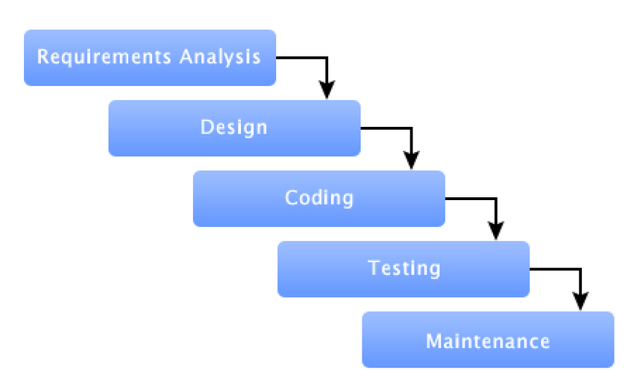
Software Process:

Slide 16

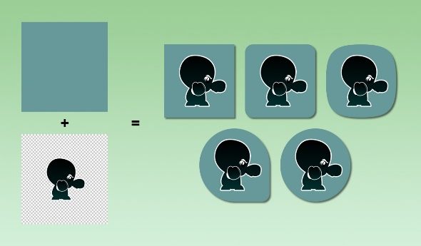
Software Development Models
Predictive VS Adaptive
Predictive
Adaptive

Slide 17
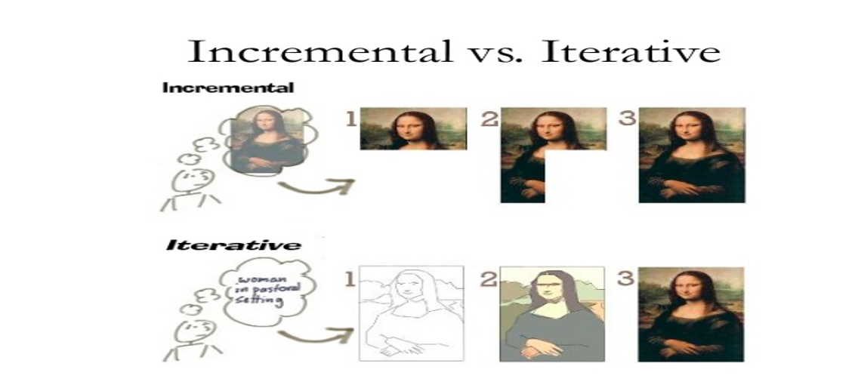
Software Development Models:

Slide 18
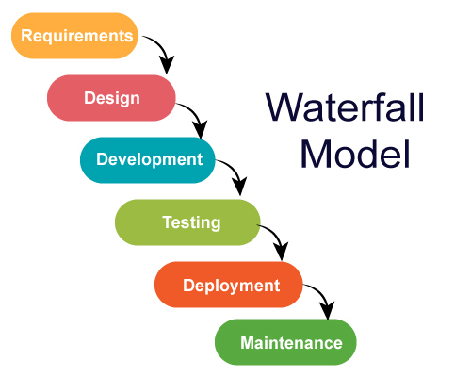
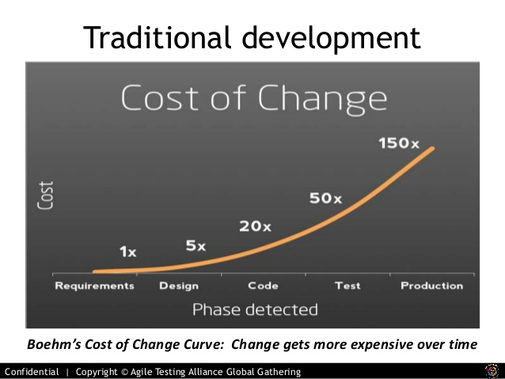
Traditional Approach:
Assumptions:
Requirements are very well understood.
Team has experience building similar projects (like ATM Machine).

Slide 19


Traditional Approach: Waterfall Model
Pros:
Easy to understand and simple
Predictable
Efficient
Cons:
Not flexible for change
First release take a long time
Use:
Repeated Project
For Predictable project
Is it predictive or adaptive?
Predictive

Slide 20
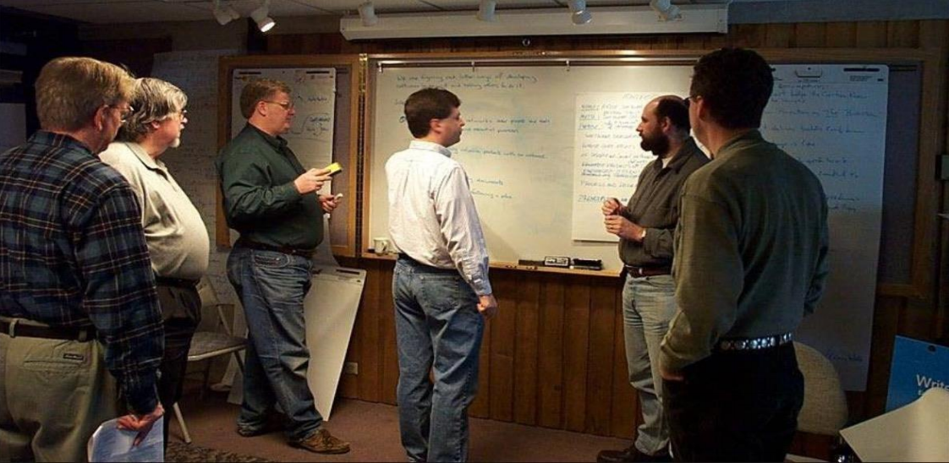
Agile Mindset:
And agile was born … 2001

Slide 21
Agile Manifesto:
We are uncovering better ways of developing software by doing it and helping others do it. Through this work we have come to value:
Individuals and interactions over processes and tools
Working software over comprehensive documentation
Customer collaboration over contract negotiation
Responding to change over following a plan
That is, while there is value in the items on the right, we value the items on the left more.”

Slide 22
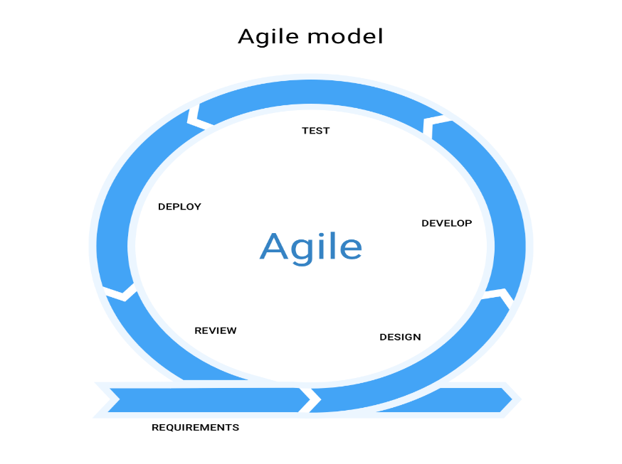
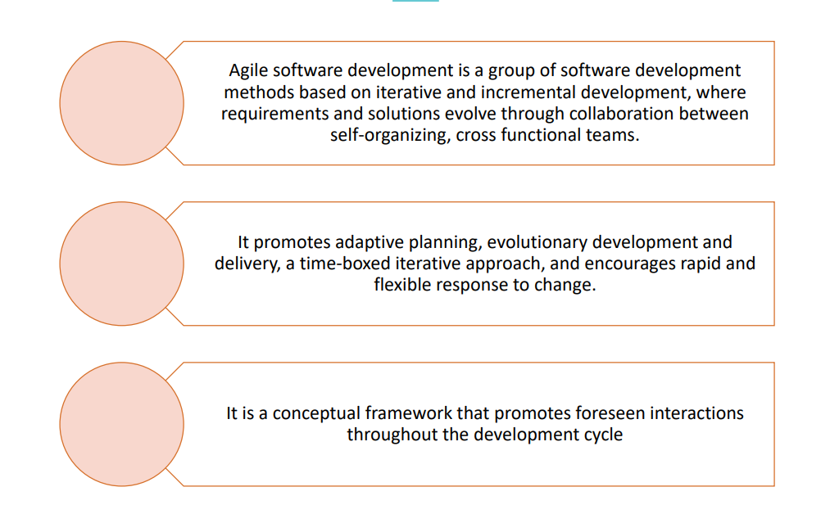
What is Agile?

